Slide 1
Energy Usage In SC
Brealin Redecker and Griffin Schwartz

Slide 2
Business Questions:
The energy company known as eSC, which supplies electricity to homes in South Carolina and parts of North Carolina. eSC is increasingly concerned about the effects of global warming, particularly its potential to raise the demand for electricity. They are particularly worried that the next summer might overwhelm their electrical grid—essentially, their capacity to deliver power to customers who need to cool their homes. This surge in demand could lead to blackouts, which eSC is keen to avoid. To address these concerns, the company is focusing on understanding potential energy consumption during an unusually hot summer, with specific attention to the month of July, which they believe is typically the peak period for energy use.

Slide 3
Overview of Data
150 Different Buildings Energy Usage
50 Different Counties for Weather
228 Variables
July 1st through 31st
Specifically 2pm (or 1400)
Using these specifications we ended up with 4650 observations and 228 variables in our data.

Slide 4

Models
In our exploration of all of our data we used 5 different models. First we explored linear regression models under 3 different categories: building infrastructure, appliance usage, and weather. In our data we decided to use 1400, or 2pm, to determine our data. This is our summary for our_data$month_total_electricity_usage which is what we want to predict throughout our models.

Slide 5
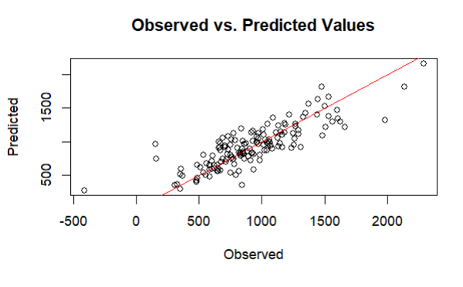
Model 1
Model 1 represents variables that have to do with essential building information and see what effect that they have on the total energy usage for the month.

Slide 6
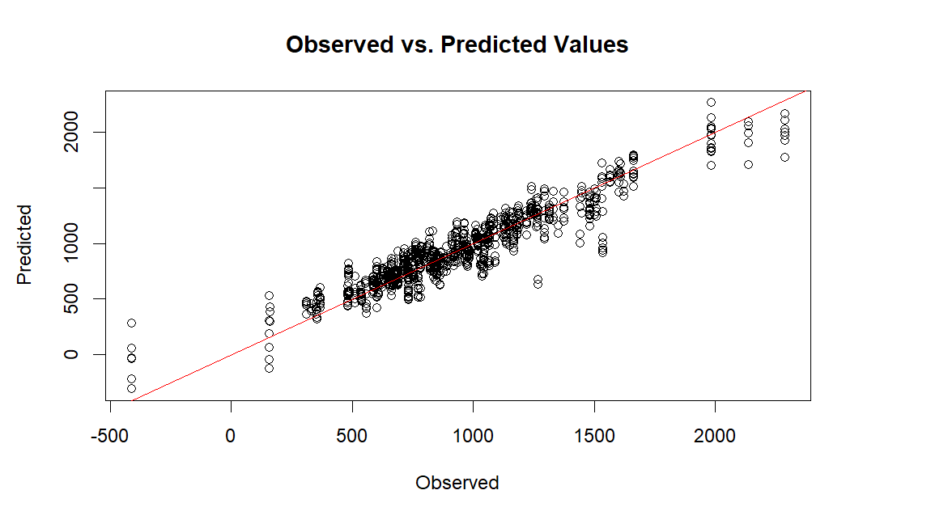
Model 2
Model 2 represents variables that have to do with application usage and see what effect that they have on the total energy usage for the month.

Slide 7
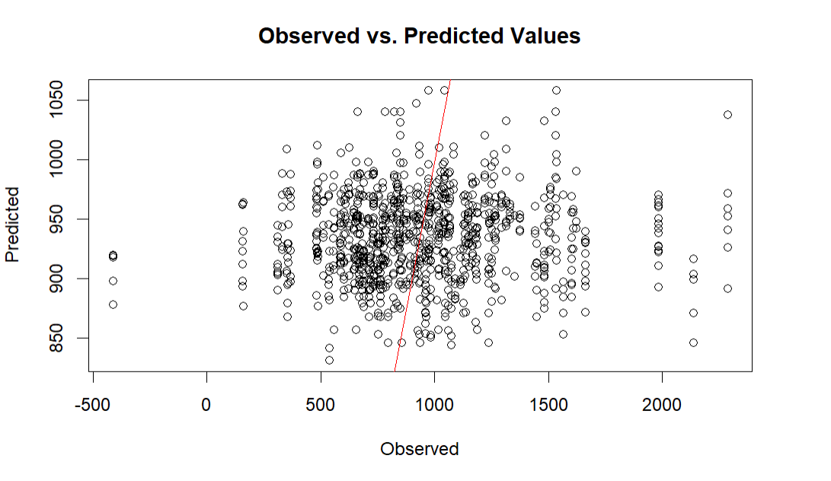
Model 3
Model 3 represents variables that have to do with weather and see what effect that they have on the total energy usage for the month.

Slide 8
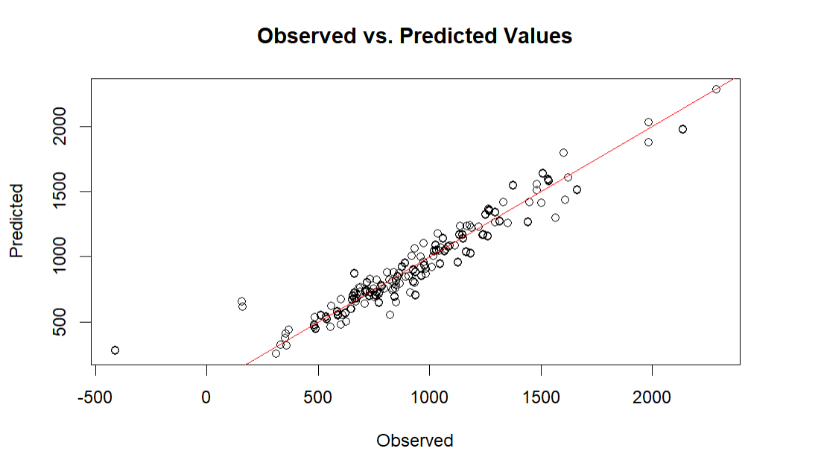
Model 4: Refined Comprehensive
Heating/Cooling Setpoints
Ducted Heating & No Cooling
Larger Building = Higher Electricity Usage
Clothes Washer, Plug Loads, Lighting Interior, Refrigerator, Hot Water, and Range Oven

Slide 9
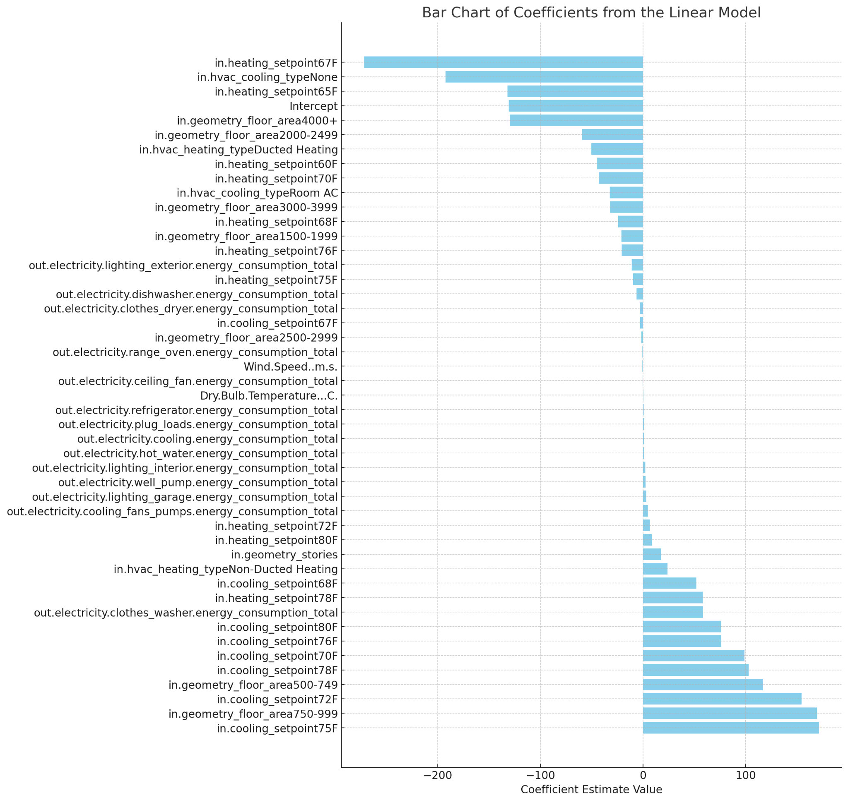
Cooling Setpoints = More Energy Usage
Lower Heating = Less Energy Usage

Slide 10
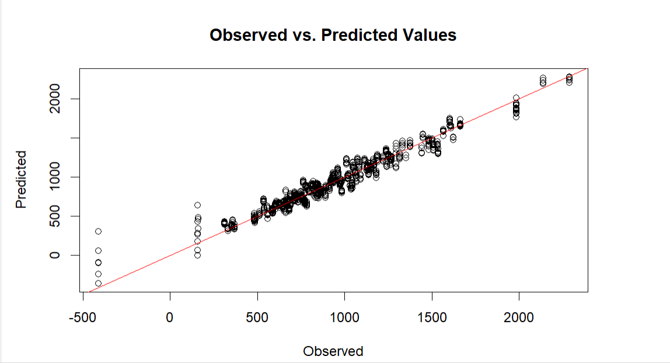
Model 5: Full Comprehensive
17 Singularities
NOT An Effective Model

Slide 11
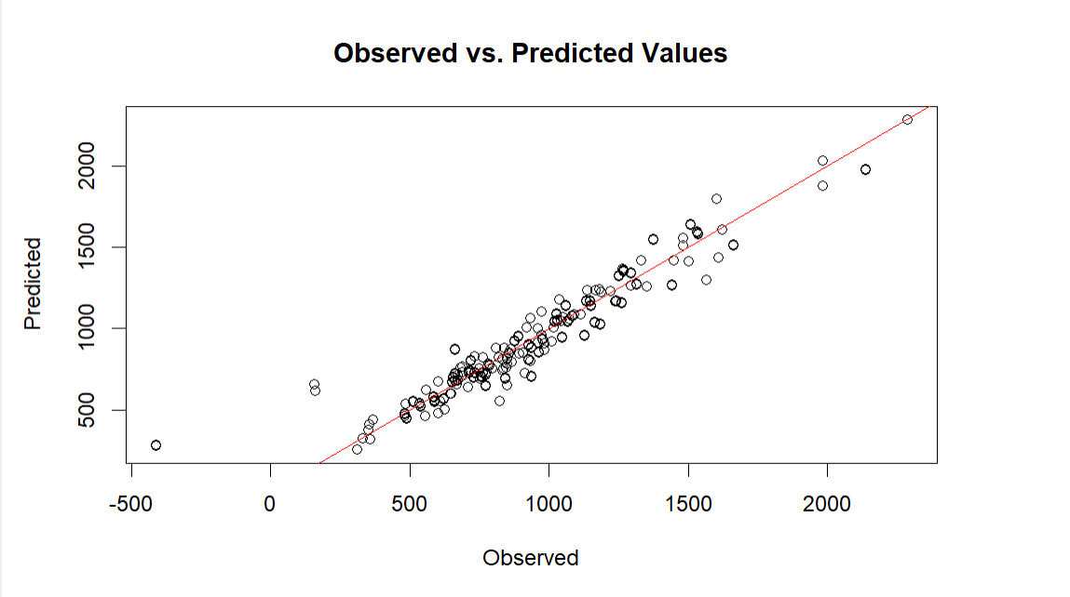
Model 6: Adding 5 Degrees
Temperature Does NOT Have A Significant Effect On Electricity Usage

Slide 12
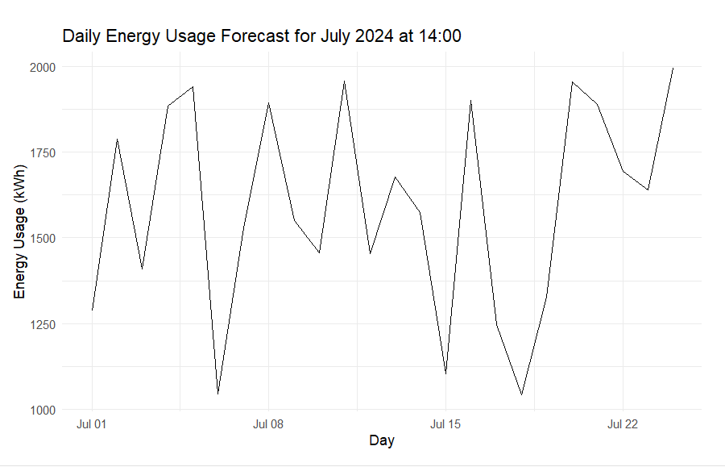
PREDICTING PEAK AND FUTURE DEMAND
Model 4
Peak Demand: 2287.721 kWh
Near the end of the month.

Slide 13
Key Variables and Their Impacts:
HVAC and Setpoints:
Cooling Setpoints: Higher cooling setpoints generally have positive coefficients, indicating an increase in electricity usage as the temperature setpoint is raised.
Heating Setpoints: Conversely, some heating setpoints have negative impacts, which could reflect energy savings from lower heating demands at certain thresholds.
Floor Area:
Smaller Areas: Certain smaller floor areas appear to have positive impacts on electricity usage, perhaps due to less efficient energy use or different lifestyle patterns.
Larger Areas: Some larger floor areas have negative coefficients, suggesting more efficient energy use or different usage patterns that lead to lower relative electricity consumption.
Appliance Usage:
Specific Appliances: The energy consumption totals for appliances like clothes washers, dishwashers, and cooling systems are significant predictors of total electricity usage, with some contributing positively and others negatively.

Slide 14
Practical Implications:
Energy Management: Understanding these relationships helps in managing energy more effectively, particularly by focusing on modifying setpoints and managing appliance use.
Policy and Planning: Insights from this analysis can inform building codes, energy efficiency standards, and incentives for using energy-efficient appliances.

